Slide 1

Are Premium Airlines
Also Premium in
Performance?
An Analysis for Business Air Commuters

Slide 2
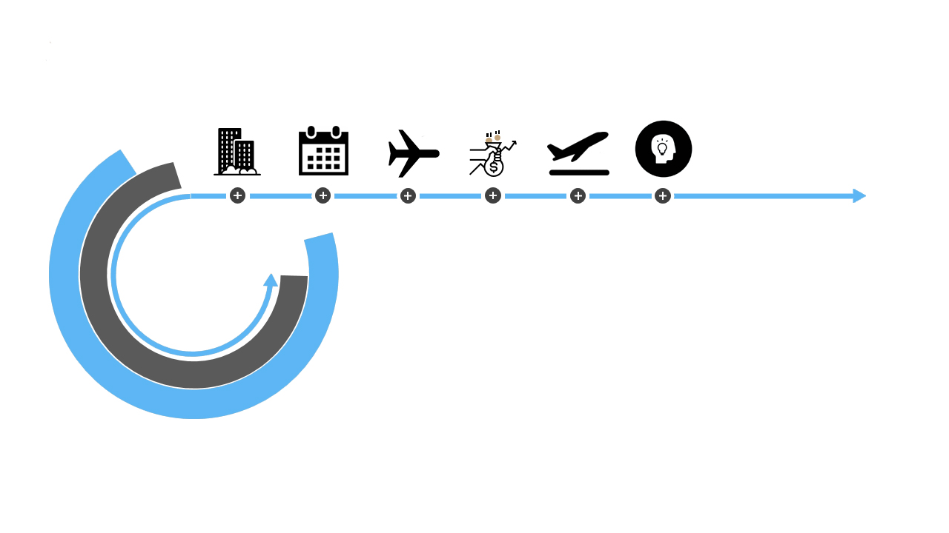
Ticket Ordering Process
From planning to user experience
Decide where you want to go
Decide when you want to go
Choose from one of the multiple airlines
Choose the cheapest airline (1)
Fly!
Experience the airline’s performance (and delays)
1. Source: SkyScanner, 2014, https://www.skyscanner.net/press-releases/flight-price-and-convenience-most-important-flyers-say-skyscanner-users

Slide 3


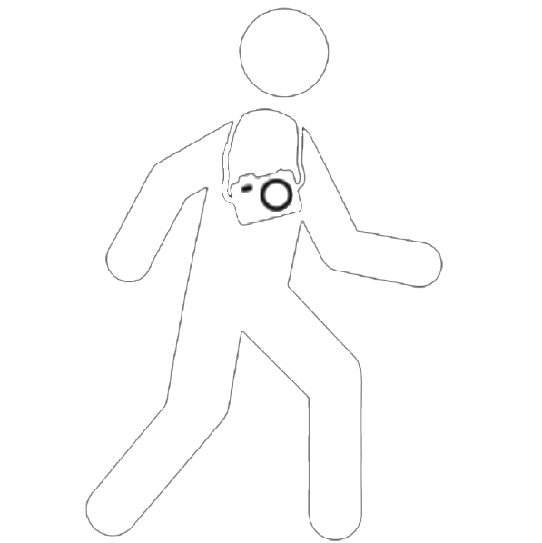
Performance Expectancy
A different perspective
Business Man
Tourist
Needs to go to a meeting
Is flying during working hours (+$100/hour)
Demands punctuality
Is visiting friends or family
Can fly at any moment of the day or week
Delays will not influence him much
Financial District
Statue of
Liberty
Time Square
Wall Street

Slide 4
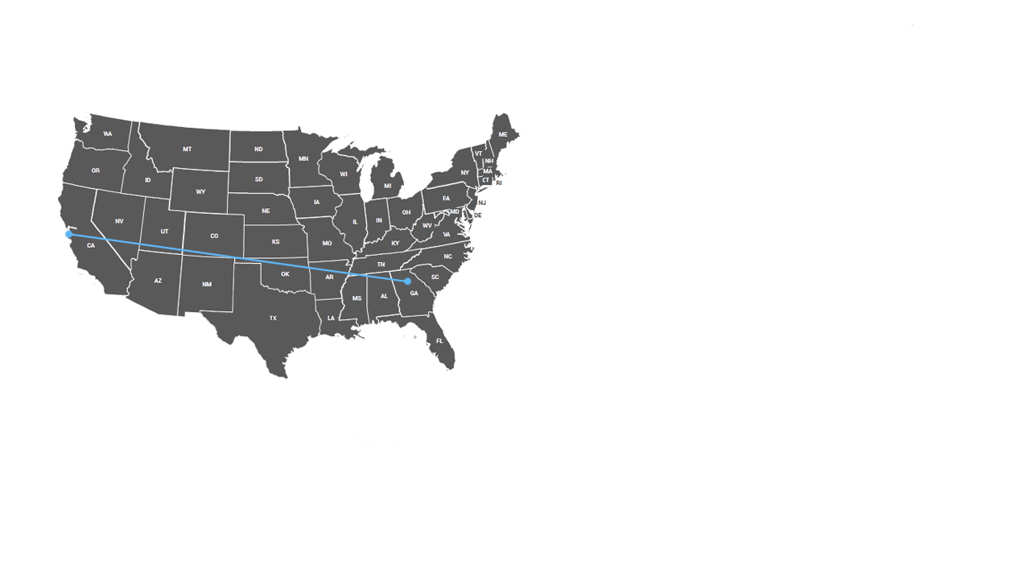
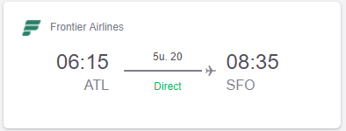
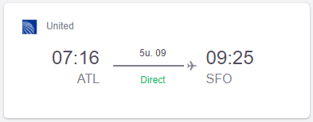
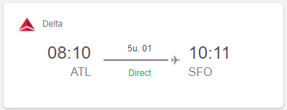
The abundance of possibilities
The business man’s perspective
Flight options:
Flightdate: 16 Aug, 23 Aug 2017, roundtrip
SFO
€ 253,-
ATL
€ 399,-
€ 357,-
54 results
Source: SkyScanner, checked 14 Aug, 2017.
https://www.skyscanner.nl/transport/vluchten/atla/sfo/170816/170823/vliegtarieven-van-atlanta-naar-san-francisco-internationaal-in-augustus-2017.html?adults=1&children=0&adultsv2=1&childrenv2=&infants=0&cabinclass=economy&rtn=1&preferdirects=false&outboundaltsenabled=false&inboundaltsenabled=false&ref=home

Slide 5
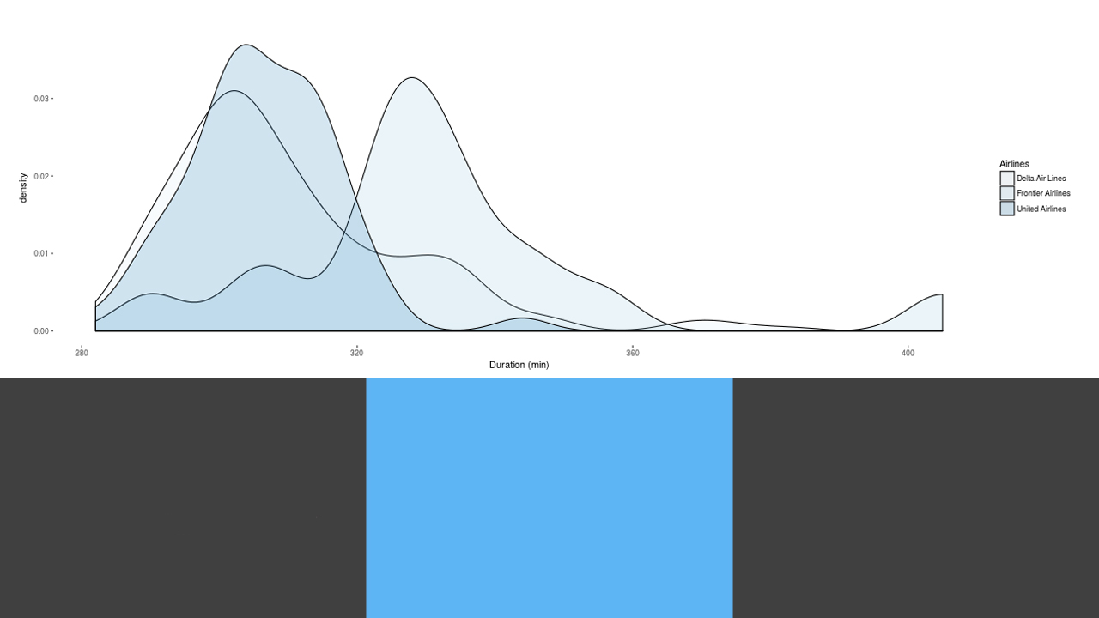
United Airlines
Frontier Airlines
Delta Airlines
Performance
Evaluation
An Analytical perspective through Shiny and R
Comparing Flight
Comparing Airlines
Airline Duration
Delta Air Lines: 310 +/- 2 min
Frontier Airlines: 332 +/- 10 min
United Airlines: 306 +/- 2 min
Airline Duration
Frontier – Delta: Longer
United – Delta: The same
United – Frontier: Shorter
95% Confidence Interval
TuckeyHSD α = 0.05

Slide 6



The Future of Flight Planning
Changing the way we travel
Delta Airlines
Giving passengers the possibility to compare airlines’ performance on unbiased information collected by the US Bureau of Transport Statistics
Giving passengers insights into the punctuality of airlines and if route performance differs significantly
Creating an insentive for airlines to compete on punctuality, as information becomes accessable to the public
Making sure passengers arrive with the least amount of delay, while minimizing ticket prices

Slide 7
Are Premium Airlines
Also Premium in
Performance?
An Analysis for Business Air Commuters
Thank you for your attention

